Slide 1
Today and Next Week…
Today
Lecture - Big Data Analysis, Technology Concepts, and Techniques
Go over Assignment 1 - http://bsharve.github.io
Python/Portfolio/Github – Installation and Setup
Next Week
Lecture - Exploratory Data Analysis (EDA) and Statistical Inference
Upcoming Student Research Proposal
Proposal is Due: 9/28
email to: bsharve@email.gwu.edu
10/5 we will:
Assignment 1 Due and give out Assignment 2 Instructions

Slide 2
Lecture: 4 Big Data Analysis, Technology Concepts, and Techniques
Benjamin Harvey
Department of EMSE and CS
Data Analytics Program
The George Washington University
E-mail: bsharve@email.gw.edu
Web: https://bsharvey.github.io

Slide 3
Agenda 9/21 - Big Data Analysis, Technology Concepts, and Techniques
Analysis Concepts: Models, EDA, CDA, Data Product, Statistics, Machine Learning, Data Munging,
A/B Testing
Correlation and Regression
Heat Maps
Time Series Analysis
Network Analysis
Spatial Data Analysis
Classification and Clustering
Outlier Detection Filtering (including collaborative filtering & content-based filtering)
Natural Language Processing
Sentiment Analysis
Text Analytics

Slide 4
Agenda – Enterprise Technologies and Big Data Business Intelligence
Research and Development Processing
Batch Processing
Stream Processing
Business Intelligence Processing
Online Analytical Processing (OLAP)
Online Transaction processing (OLTP)
Extract Transform Load (ETL) Data
Warehouses
Data Marts
Traditional Business Intelligence (BI)
Big Data Business Intelligence (BI)
Understand the business side is key to success and this is what bringing in an Industry/Gov’t prof. allows
Analytic Lifecycle: Business Case Evaluation (BCE) - EACOE
Organization and Analysis

Slide 5
Big Data Analysis Techniques and Technology
Statistical analysis techniques are commonly preferred for exploratory data analysis (EDA), after which computational techniques that leverage the insight gleaned from the statistical study of a dataset can be applied.
In the long run, an organization will operate its Big Data analysis engine at two speeds:
processing streaming data as it arrives and
performing batch analysis of this data as it accumulates to look for patterns and trends.
The shift from batch to real-time presents other challenges as real-time techniques need to leverage computationally-efficient algorithms.

Slide 6
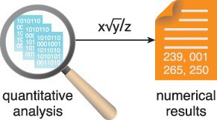
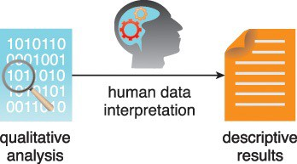
Big Data Analysis Techniques
Quantitative Analysis
Quantitative analysis is a data analysis technique that focuses on quantifying the patterns and correlations found in the data
Qualitative Analysis
Qualitative analysis is a data analysis technique that focuses on describing various data qualities using words
Figure 8.2 The output of quantitative analysis is numerical in nature.
Figure 8.3 Qualitative results are descriptive in nature and not generalizable to the entire dataset

Slide 7
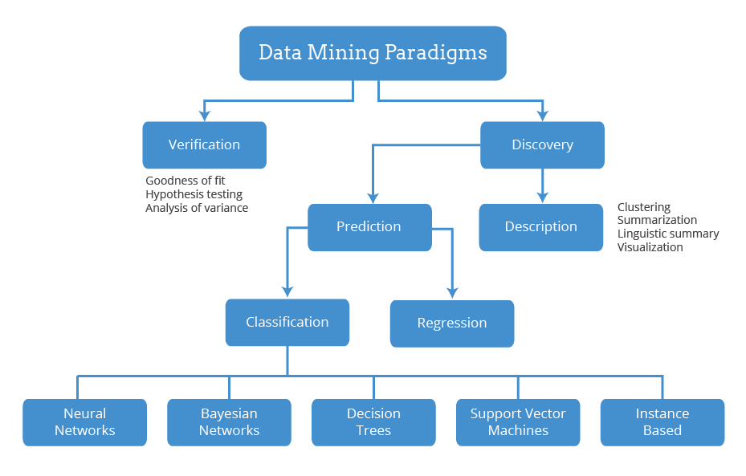
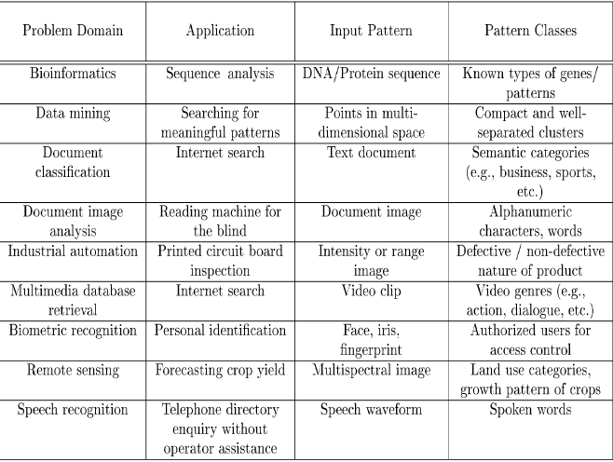
Big Data Analysis Techniques
Data Mining
Or data discovery, is a specialized form of data analysis that targets large datasets.
Techniques include automated, software-based technique that sift through massive datasets to identify patterns and trends.
Feature Extraction

Slide 8
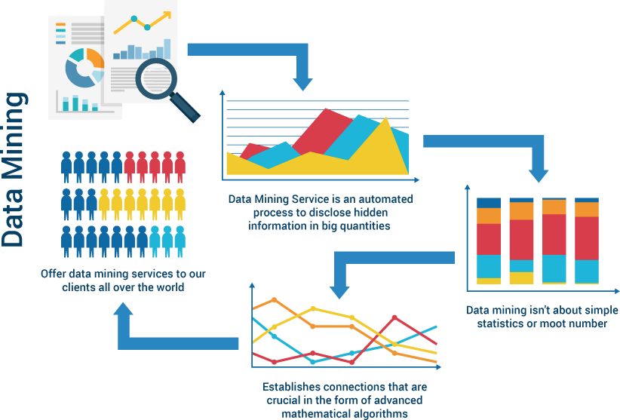
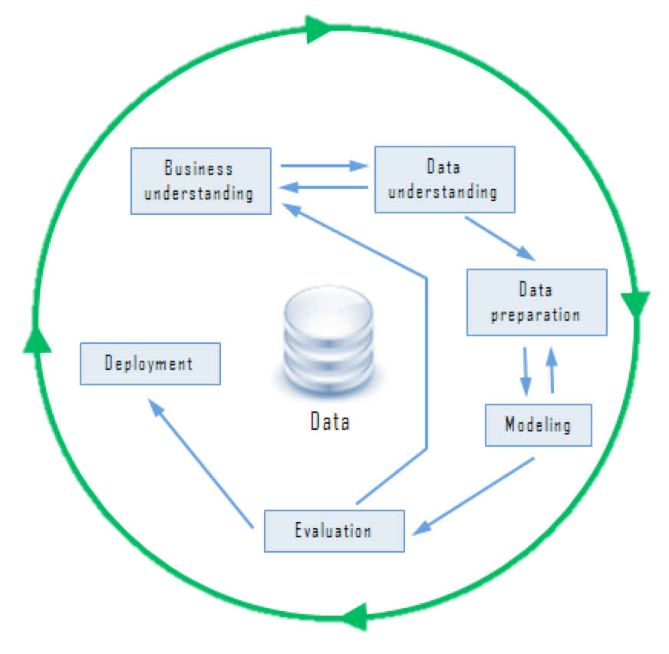
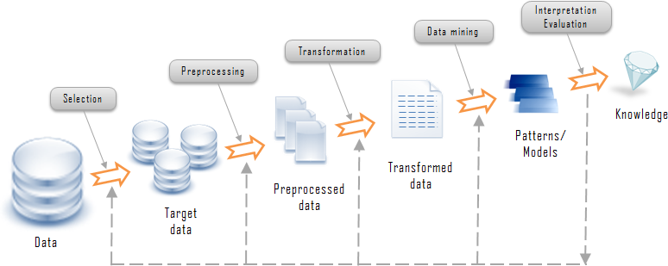
Data Mining Process
Data Mining
Verification
http://www.customdatahub.com/data-mining/

Slide 9
Big Data Analysis Techniques
Statistical Analysis
A/B Testing
A/B testing, also known as split or bucket testing, compares two versions of an element to determine which version is superior based on a pre-defined metric.
Covariance Correlation
Covariance and Correlation is an analysis technique used to determine whether two variables are related to each other.
Correlation assumes that both variables are independent.
Regression
The analysis technique of regression explores how a dependent variable is related to an independent variable within a dataset.
applicable to variables that have previously been identified as dependent and independent variables and implies that there is a degree of causation between the variables.

Slide 10
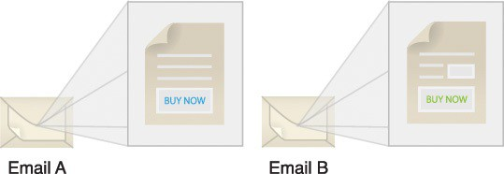
A/B Testing
Figure 8.5 Two different email versions are sent out simultaneously as part of a marketing campaign to see which version brings in more prospective customers.
Sample questions can include:
Is the new version of a drug better than the old one?
Do customers respond better to advertisements delivered by email or postal mail?
Is the newly designed homepage of the Web site generating more user traffic?

Slide 11
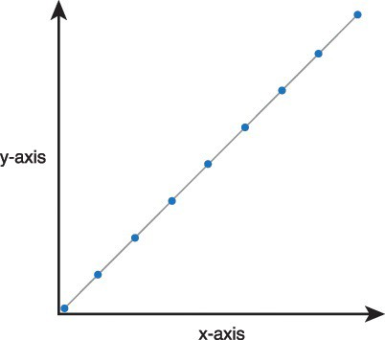
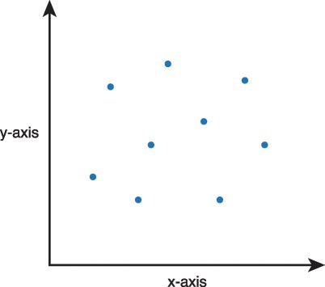
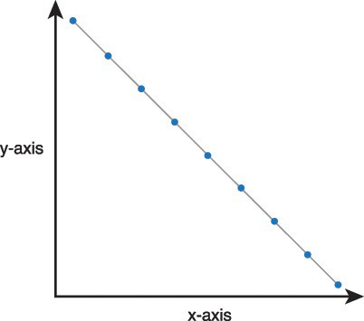
Correlation
Correlation is expressed as a decimal number between –1 to +1, which is known as the correlation coefficient. The degree of relationship changes from being strong to weak when moving from –1 to 0 or +1 to 0.
Correlation assumes that both variables are independent.
Figure 8.6 When one variable increases or decreases, the other also increases decreases and vice versa.
Figure 8.7 When one variable increases, the other may stay the same, or increase or decrease arbitrarily
.
Shows a correlation of +1, which suggests that there is a strong positive relationship between the two variables.
A slope of –1 suggests that there is a strong negative relationship between the two variables.

Slide 12
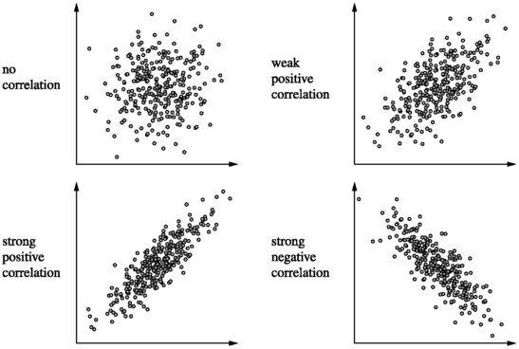
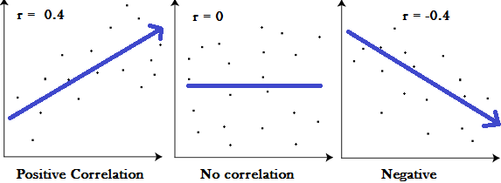
Correlation
strong to weak when moving from –1 to 0 or +1 to 0

Slide 13
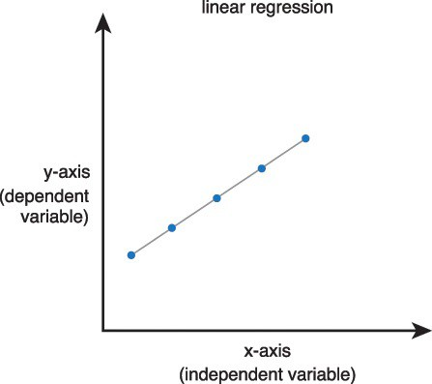
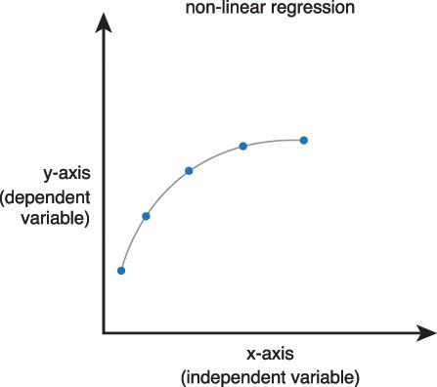
Regression
Sample questions can include:
What will be the temperature of a city that is 250 miles away from the sea?
What will be the grades of a student studying at a high school based on their primary school grades?
What are the chances that a person will be obese based on the amount of their food intake?
Normal
Abnormal
Figure 8.9 Linear regression
Figure 8.10 Non-linear regression
Figure 8.10 Non-linear regression
Figure 8.10 Non-linear regression

Slide 14
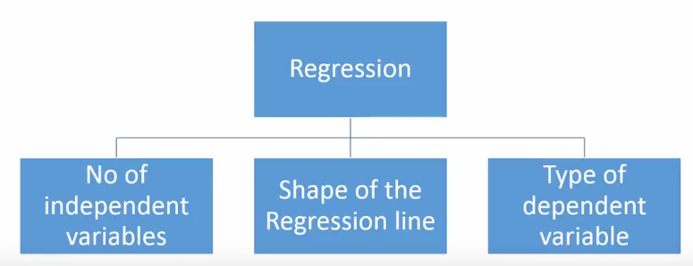
Regression
7 types of Regression that you should know
Linear Regression
Logistic Regression
Polynomial Regression
Stepwise Regression
Ridge Regression
Lasso Regression
ElasticNet Regression
Select regression type based upon

Slide 15
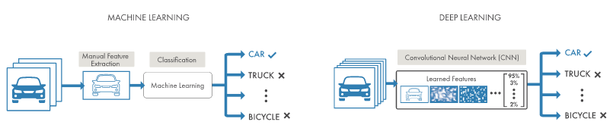

Big Data Analysis Techniques
Machine Learning
application of artificial intelligence (AI) that provides systems the ability to automatically learn and improve from experience without being explicitly programmed
Deep Learning
Machine Learning technique that use a cascade of many layers of nonlinear processing units for feature extraction and transformation. Each successive layer uses the output from the previous layer as input.
The algorithms may be supervised or unsupervised and applications include pattern analysis (unsupervised) and classification (supervised). are based on the (unsupervised) learning of multiple levels of features or representations of the data. Higher level features are derived from lower level features to form a hierarchical representation.
Notes:
when human knowledge can be combined with the processing speed of machines, machines will be able to process large amounts of data without requiring much human intervention.

Slide 16
Machine Learning Techniques
Classification
Classification is a supervised learning technique by which data is classified into relevant, previously learned categories. It consists of two steps:
The system is fed training data that is already categorized or labeled, so that it can develop an understanding of the different categories.
The system is fed unknown but similar data for classification and based on the understanding it developed from the training data, build a model, then algorithm will classify the unlabeled data
Clustering
Clustering is an unsupervised learning technique by which data is divided into different groups so that the data in each group has similar properties.
Outlier Detection
Outlier detection is the process of finding data that is significantly different from or inconsistent with the rest of the data within a given dataset
Filtering
Filtering is the automated process of finding relevant items from a pool of items. Filtering is generally applied via the following two approaches:
collaborative filtering
content-based filtering

Slide 17
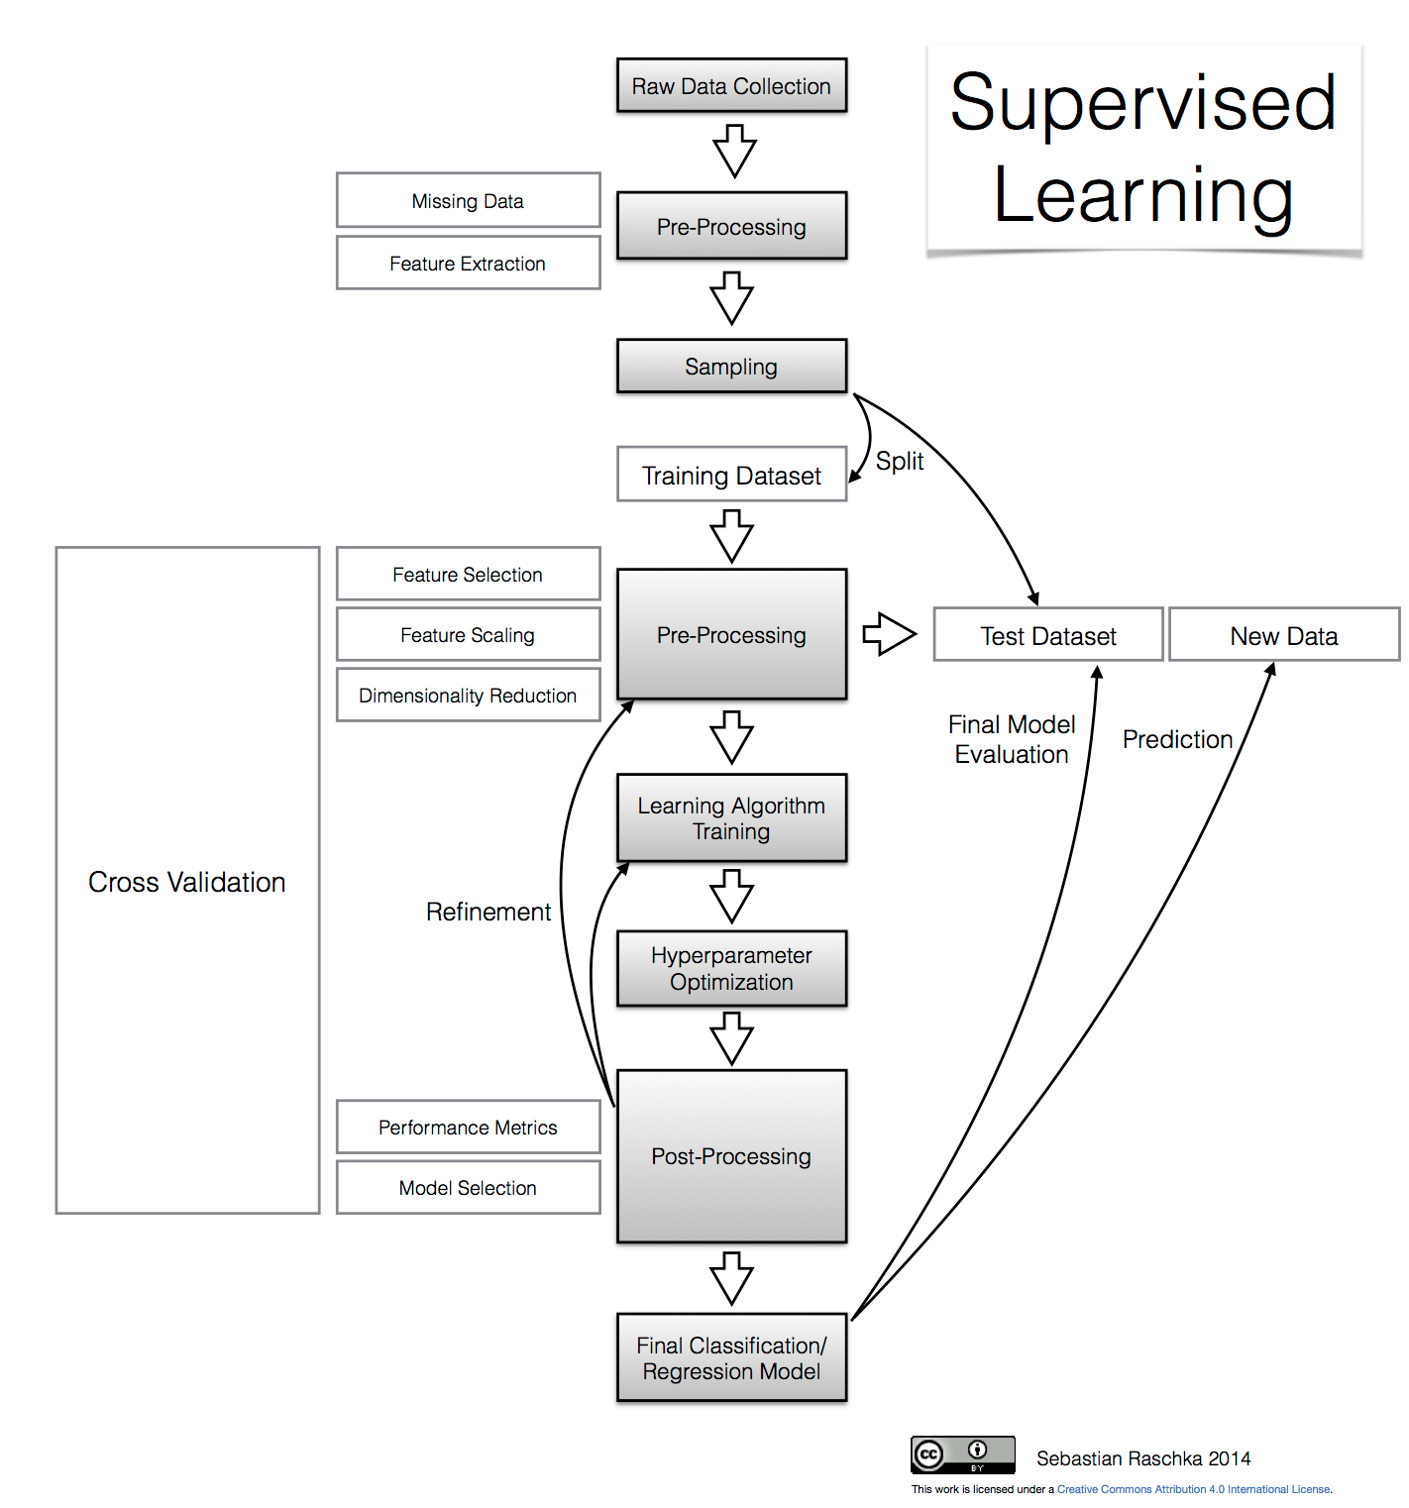
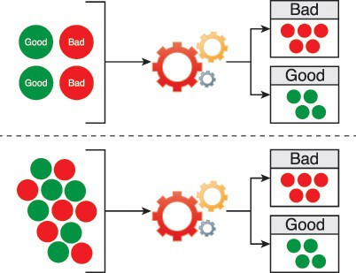
Classification
Train Model
Apply Model
A simplified classification process, the machine is fed labeled data during training that builds its understanding of the classification, as shown in Figure 8.11. The machine is then fed unlabeled data, which it classifies itself.
Sample questions can include:
Should an applicant’s credit card application be accepted or rejected based on other accepted or rejected applications?
Is a tomato a fruit or a vegetable based on the known examples of fruit and vegetables?
Do the medical test results for the patient indicate a risk for a heart attack?

Slide 18
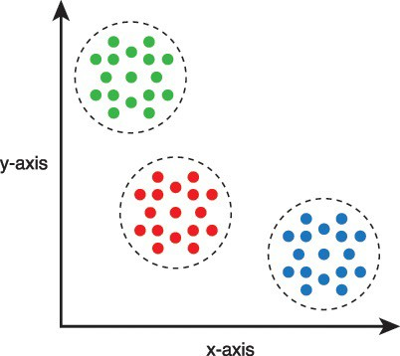
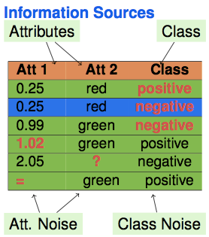
Clustering
Sample questions can include:
How many different species of trees exist based on the similarity between trees?
How many groups of customers exist based upon similar purchase history?
What are the different groups of viruses based on their characteristics?

Slide 19
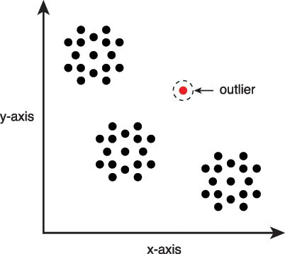
Outlier Detection
Model-based Approaches:
Rational
Apply a model to represent normal data points
Outliers are points that do not fit to that model
Sample approaches
Probabilistic tests based on statistical models – distribution models
Depth-based approaches
Deviation-based approaches
Some subspace outlier detection approaches
Proximity-based Approaches
Rational
Examine the spatial proximity of each object in the data space
If the proximity of an object considerably deviates from the proximity of other objects it is considered an outlier
Sample approaches
Distance-based approaches
Density-based approaches
Some subspace outlier detection approaches
Figure 8.13 A scatter graph highlights an outlier.
Sample questions can include:
Is an athlete using performance enhancing drugs?
Are there any wrongly identified fruits and vegetables in the training dataset used for a classification task?
Is there a particular strain of virus that does not respond to medication?
Notes:
Solutions
• Use more robust distance functions and find full-dimensional outliers
• Find outliers in projections (subspaces) of the original feature space

Slide 20

Filtering
Types of filtering:
Supervised
Instance Based
Attribute Based
Unsupervised
Instance Based
Attribute Based
Sample questions can include:
How can only the news articles that a user is interested in be displayed?
Which holiday destinations can be recommended based on the travel history of a vacationer?
Which other new users can be suggested as friends based on the current profile of a person?

Slide 21
Big Data Analysis Techniques
Semantic Analysis
Text Analytics
Parsing text within documents to extract:
Named Entities – person, group, place, company
Pattern-Based Entities – social security number, zip code
Concepts – an abstract representation of an entity
Facts – relationship between entities
Categorization of documents using these extracted entities and facts.
Natural Language Processing
Natural language processing is a computer’s ability to comprehend human speech and text as naturally understood by humans.
Sentiment Analysis
Sentiment analysis is a specialized form of text analysis that focuses on determining the bias or emotions of individuals.

Slide 22
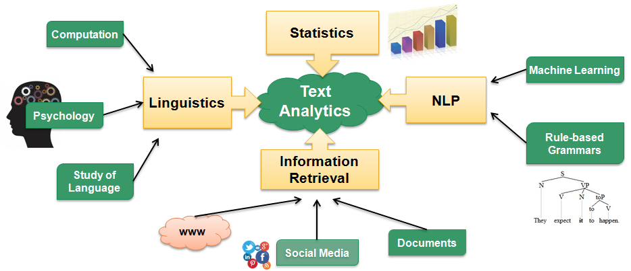
Natural Language Processing (NLP)
Sample questions can include:
How can an automated phone exchange system that can recognize the correct department extension as dictated verbally by the caller be developed?
How can grammatical mistakes be automatically identified?
How can a system that can correctly understand different accents of English language be designed?

Slide 23
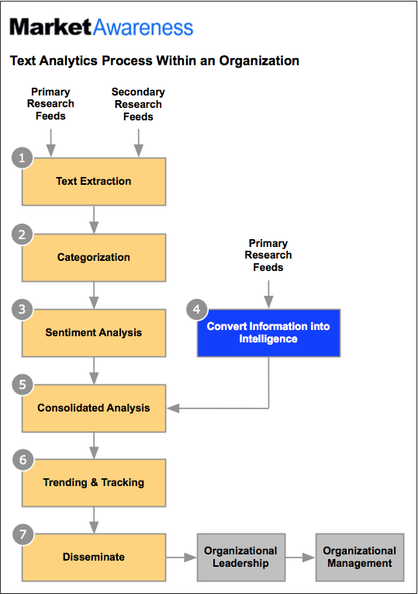
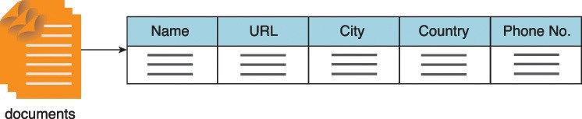
Text Analytics and Sentiment Analysis
Figure 8.14 Entities are extracted from text files using semantic rules and structured so that they can be searched.
Sample questions can include (Sentiment Analysis):
How can customer reactions to the new packaging of the product be gauged?
Which contestant is a likely winner of a singing contest?
Can customer churn be measured by social media comments?
Sample questions can include (Text Analytics):
How can I categorize Web sites based on the content of their Web pages?
How can I find the books that contain content that is relevant to the topic that I am studying?
How can I identify contracts that contain confidential company information?
Notes:
Text Analytics Process within an organization.

Slide 24
Big Data Analysis Techniques
Visual Analysis
Heat Maps
Heat maps are an effective visual analysis technique for expressing patterns, data compositions via part-whole relations and geographic distributions of data.
Time Series Plots
Time series plots allow the analysis of data that is recorded over periodic intervals of time. This type of analysis makes use of time series, which is a time-ordered collection of values recorded over regular time intervals.
Network Graphs
Within the context of visual analysis, a network graph depicts an interconnected collection of entities.
It involves plotting entities as nodes and connections as edges between nodes. There are specialized variations of network analysis, including:
route optimization
social network analysis
spread prediction, such as the spread of a contagious disease
Spatial Data Mapping
Spatial or geospatial data is commonly used to identify the geographic location of individual entities that can then be mapped. Spatial data analysis is focused on analyzing location-based data in order to find different geographic relationships and patterns between entities.

Slide 25
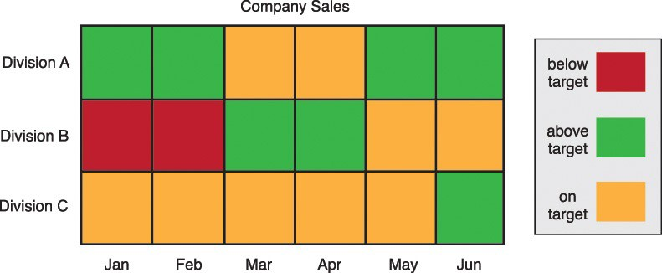
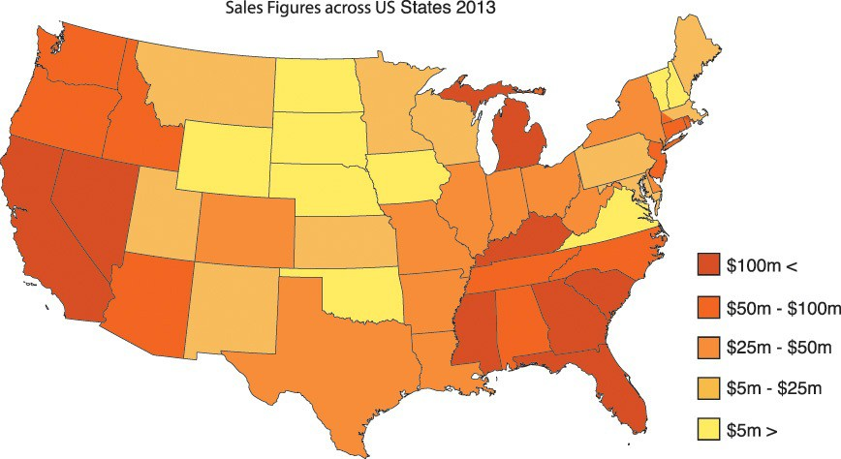
Heat Maps
Figure 8.15 This chart heat map depicts the sales of three divisions within a company over a period of six months.
Figure 8.16 A heat map of the US sales figures from 2013.
Sample questions can include:
How can I visually identify any patterns related to carbon emissions across a large number of cities around the world?
How can I see if there are any patterns of different types of cancers in relation to different ethnicities?

Slide 26
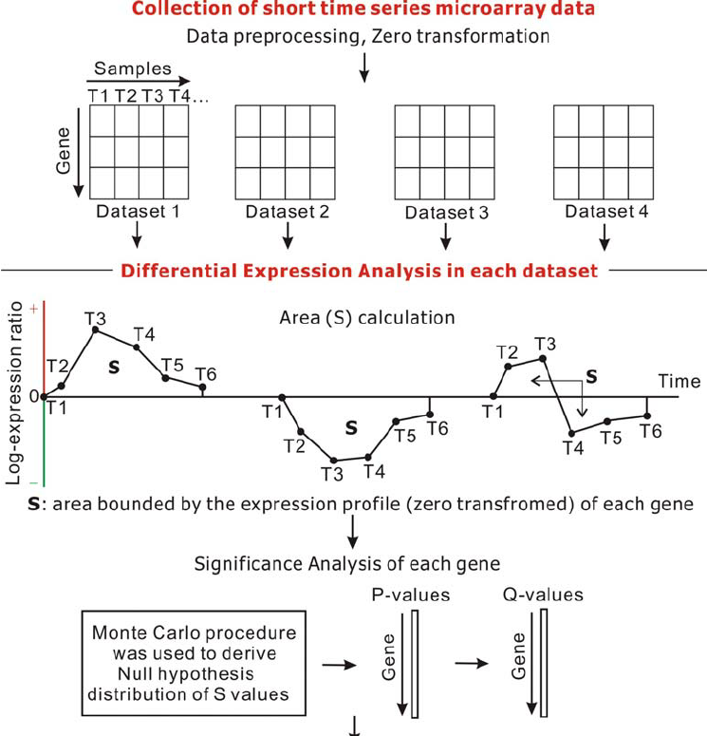
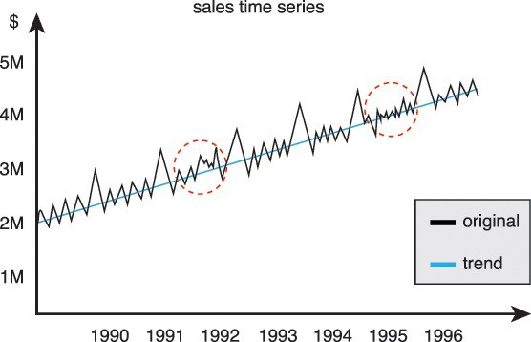
Time Series Plots
Figure 8.17 A line chart depicts a sales time series from 1990 to 1996.
Sample questions can include:
How much yield should the farmer expect based on historical yield data?
What is the expected increase in population in the next 5 years?
Is the current decrease in sales a one-off occurrence or does it occur regularly?
Sun, Ruping & Fu, Xuping & Guo, Fenghua & Ma, Zhaorong & Goulbourne, Chris & Jiang, Mei & Li, Yao & Xie, yi & Mao, Yumin. (2009). A strategy for meta-analysis of short time series microarray datasets. Frontiers in bioscience : a journal and virtual library

Slide 27
Time Series Analysis
Time Series Decomposition
Trend component: long term trend
Seasonal component: seasonal variation
Cyclical component: repeated but non-periodic fluctuations
Irregular component: the residuals
Time Series Forecasting - to forecast future events based on known past data
Autoregressive moving average (ARMA)
Autoregressive integrated moving average (ARIMA)
Time Series Clustering - to partition time series data into groups based on similarity or distance, so that time series in the same cluster are similar
Measure of distance/dissimilarity
Euclidean distance
Manhattan distance
Maximum norm
Hamming distance
The angle between two vectors (inner product)
Dynamic Time Warping (DTW) distance
Time Series Classification- to build a classification model based on labelled time series and then use the model to predict the label of unlabeled time series
Feature Extraction
Singular Value Decomposition (SVD)
Discrete Fourier Transform (DFT)
Discrete Wavelet Transform (DWT)
Piecewise Aggregate Approximation (PAA)
Perpetually Important Points (PIP)
Piecewise Linear Representation
Symbolic Representation

Slide 28
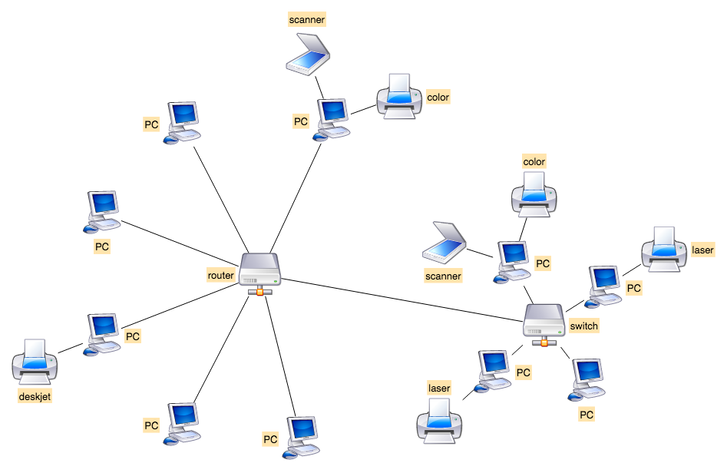
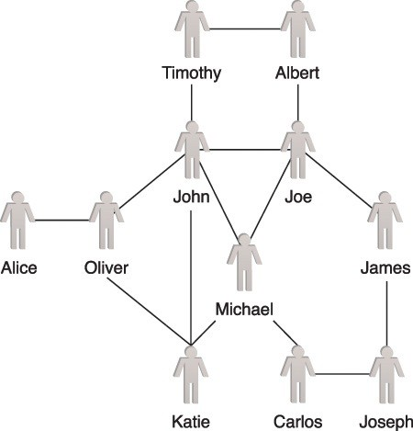
Network Graphs
An example of a using a graph to calculate platform reliability.
Figure 8.18 An example of a social network graph.
Sample questions may include:
How can I identify influencers within a large group of users?
Are two individuals related to each other via a long chain of ancestry?
How can I identify interaction patterns among a very large number of protein-to- protein interactions?

Slide 29
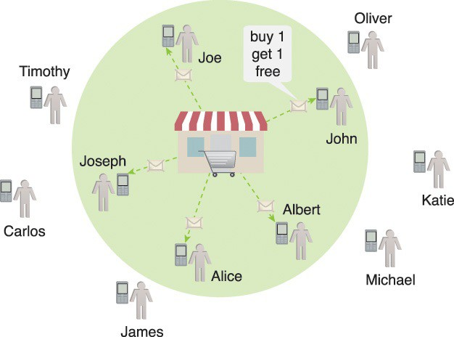
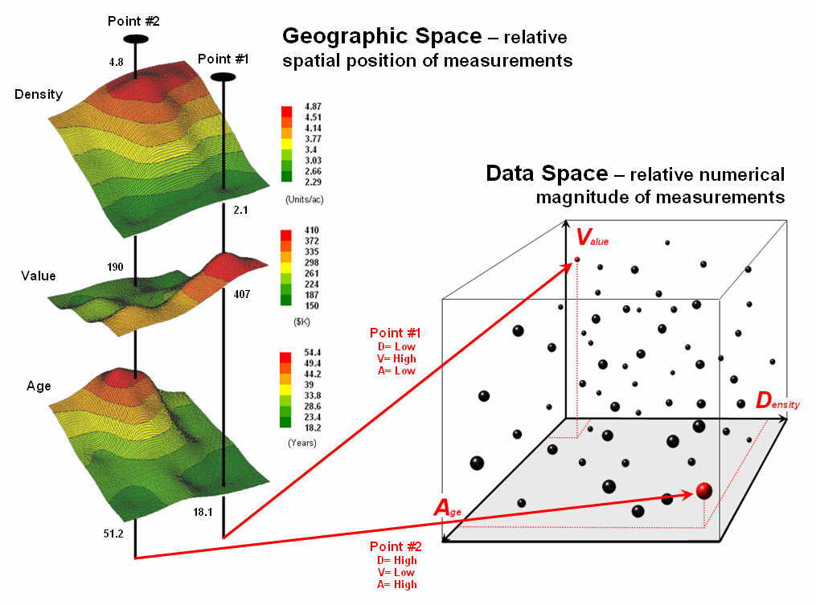
Spatial Data Mapping
Figure 8.19 Spatial data analysis can be used for targeted marketing by a supermarket is using spatial analysis for targeted marketing
Sample questions can include:
How many houses will be affected due to a road widening project?
How far do customers have to commute in order to get to a supermarket?
Where are the high and low concentrations of a particular mineral based on readings taken from a number of sample locations within an area?

Slide 30
Enterprise Technologies and Big Data Business Intelligence
BI Data is collected from throughout the enterprise and warehoused in a data warehouse, analytical processing systems answer more complex queries and can provide deeper insight into business operations, but usually used for operations.
It is from these data stores and processing that management gains insight into broader corporate performance, KPI, and for operational insight.
These systems include:
Operations/Research Storage and Processing Technologies
Stream Processing
Batch Processing
Business Storage and Processing Technologies
OLAP (Vertica, Netezza, Hadoop)
OLTP-oriented databases: (Postgres, MySQL, VoltDB, Oracle),
Hybrid OLTP and OLAP: (HBase, Cassandra, MongoDB)
Extract Transform Load (ETL) Processes
Data Warehouses
Data Marts
Notes:
Big Data is often created by high-volume feeds of incoming state that remains mutable, possibly indefinitely. It's a poor fit for traditional OLTP databases due to the volume involved and it's a poor fit for analytic databases due to the emphasis on mutable state and point queries. Both types of databases are ultimately necessary because the ideal storage layout for a given data set is determined by the queries you need to execute efficiently.

Slide 31
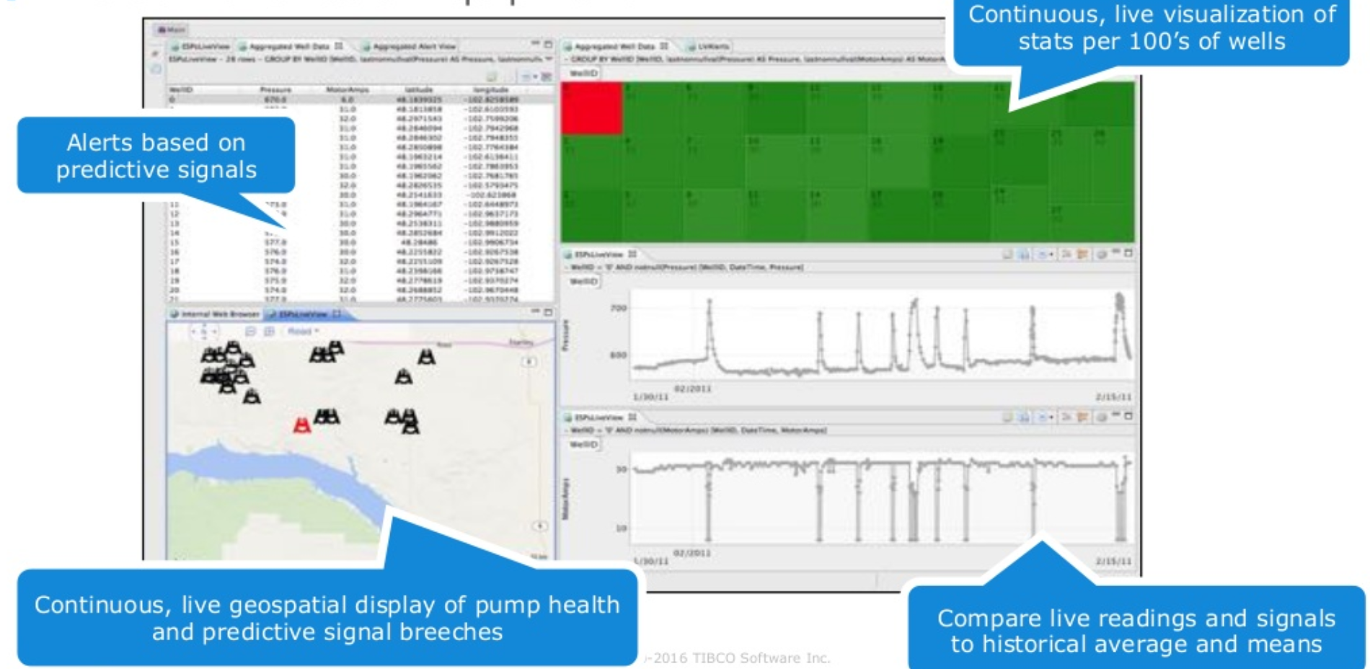
Why Streaming?
Source: Tibco.com

Slide 32
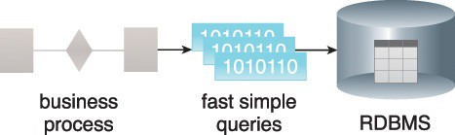
Streaming and OLTP
Streaming Processing
Under the streaming model, data is fed into analytics tools piece-by-piece. The processing is usually done in real time.
Online Transaction Processing (OLTP)
OLTP is a software system that processes transaction-oriented data. The term “online transaction” refers to the completion of an activity in real-time and is not batch-processed. OLTP systems store operational data that is normalized. This data is a common source of structured data and serves as input to many analytic processes
Figure 4.1 OLTP systems perform simple database operations to provide sub-second response times.

Slide 33
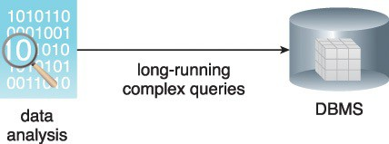
Batch and OLAP
Batch Processing
Under the batch processing model, a set of data is collected over time, then fed into an analytics system. In other words, you collect a batch of information, then send it in for processing.
Online Analytic Processing (OLAP)
Online analytical processing (OLAP) systems are used for processing data analysis queries. OLAPs form an integral part of business intelligence, data mining and machine learning processes. They are relevant to Big Data in that they can serve as both a data source as well as a data sink that is capable of receiving data. They are used in diagnostic, predictive and prescriptive analytics
Figure 4.2 OLAP systems use multidimensional databases.
Notes:
. As shown in Figure 4.2, OLAP systems perform long-running, complex queries against a multidimensional database whose structure is optimized for performing advanced analytics.

Slide 34
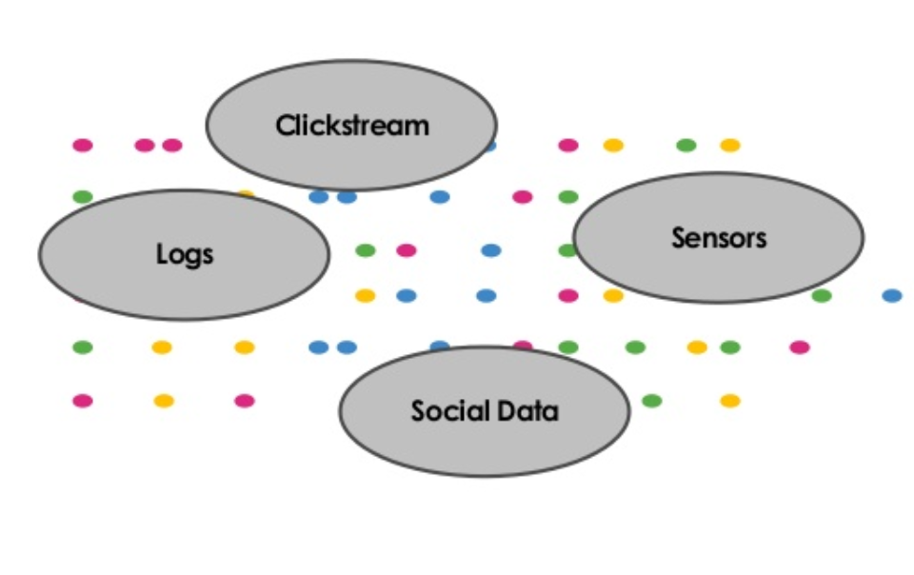
Streaming Analytics: “What Is A Stream”
Consists of pieces of data typically generated due to a change in state:
One or more identifiers
Timestamp & payload
Immutable: copy then change or delete
Typically unbounded; there is no end to the data
Batch dataset: “bounded”
Can be raw or derived
Notes:
In object-oriented and functional programming, an immutable object (unchangeable object) is an object whose state cannot be modified after it is created. This is in contrast to a mutable object (changeable object), which can be modified after it is created.

Slide 35
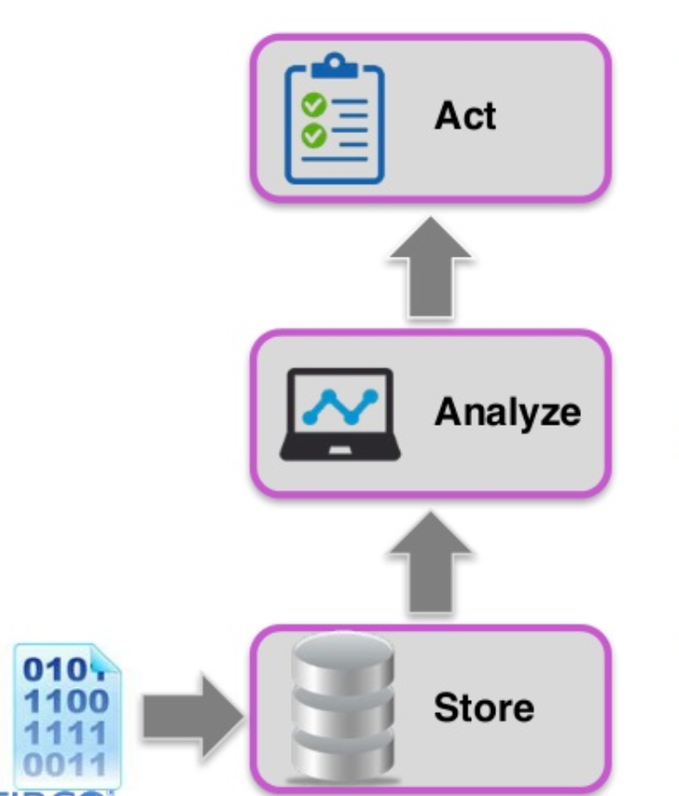
Traditional Data Processing – Request & Response
Data is collected from a variety of sources, and placed in a persistent store
Relational database
NoSQL store
Hadoop environment
Analytical processes are executed against the stored data to detect opportunities or threats
Actions are identified, delivered, and executed across various business channels

Slide 36
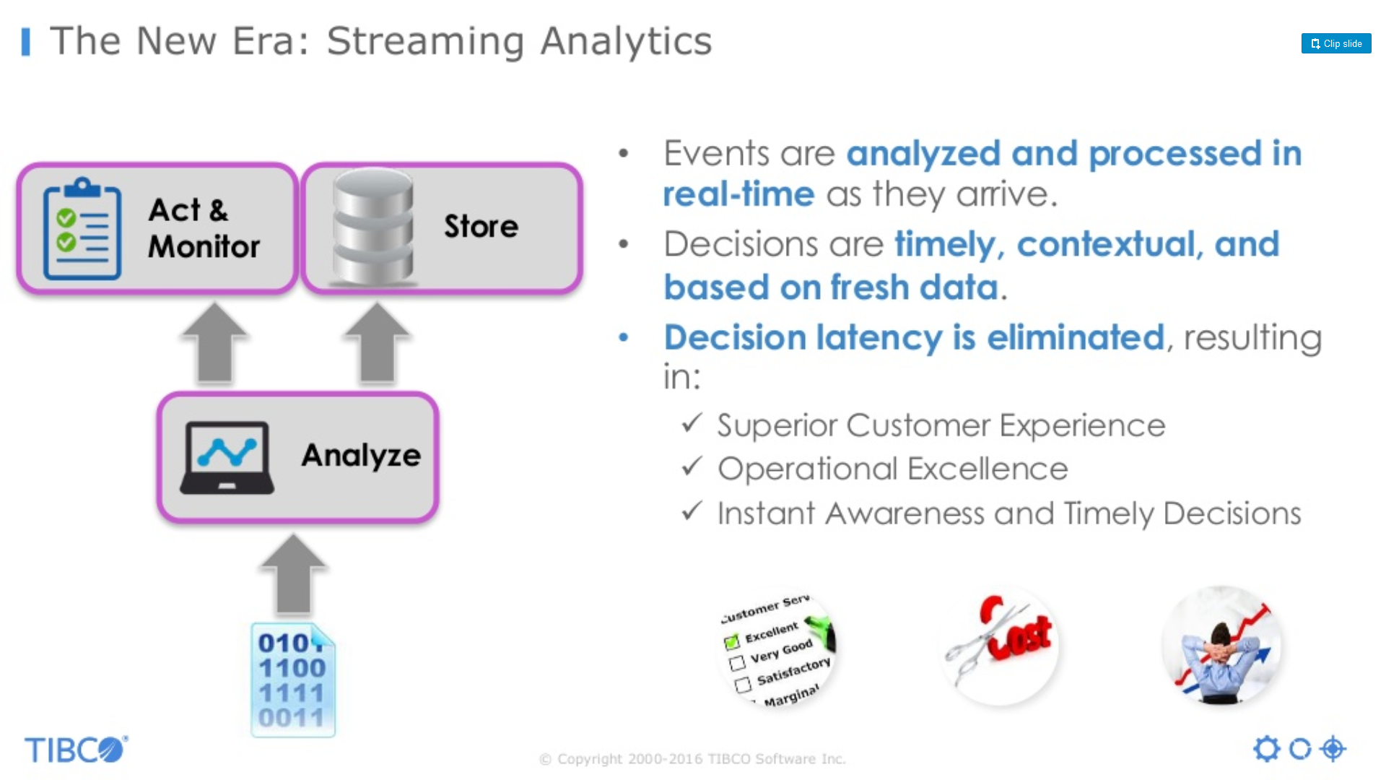
The New Era: Streaming Analytics
Events are analyzed and processed in real-time as they arrive.
Decisions are timely, contextual, and based on fresh data.
Decision latency is eliminated, resulting in:
Superior Customer Experience,
Operational Excellence,
Instant Awareness and Timely Decisions

Slide 37
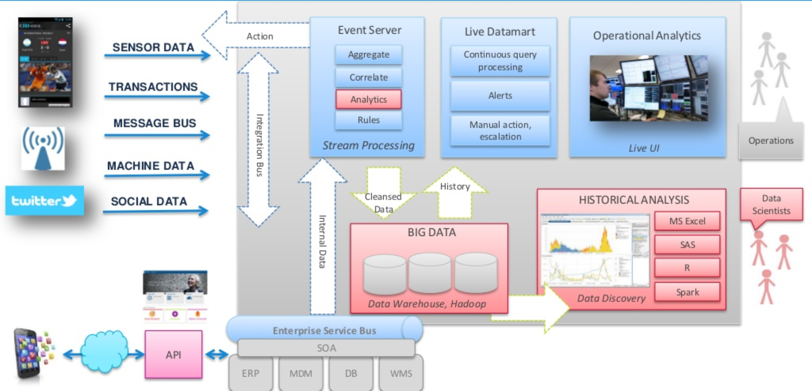
Streaming Analytics Reference Architecture
Source: tibco.com

Slide 38
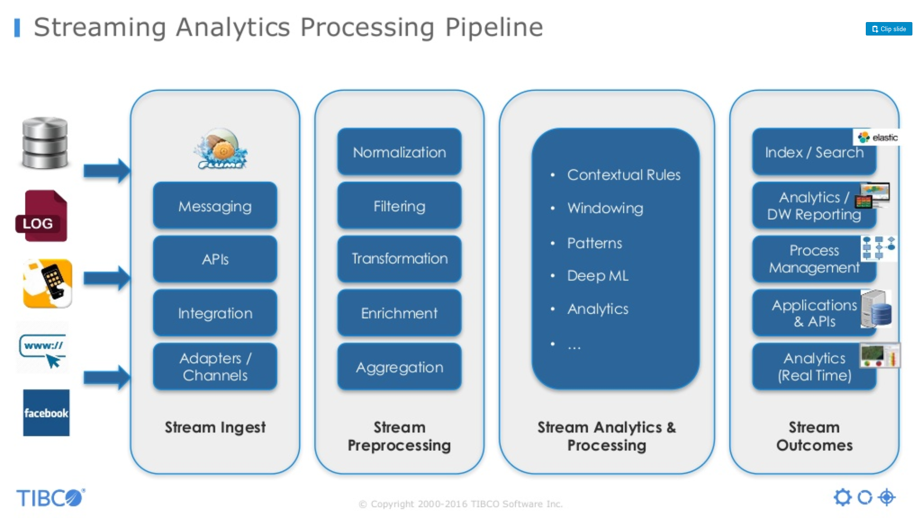
Streaming Analytics Processing Pipeline
Source: tibco.com

Slide 39
Real-time Batch Comparison
Apache Spark processes data in-memory while Hadoop MapReduce persists back to the disk after a map or reduce action, so Spark should outperform Hadoop MapReduce.
Spark needs a lot of memory. Much like standard DBs, it loads a process into memory and keeps it there until further notice, for the sake of caching.
Throughput / sec
100000s
In-Memory Computing
Interactive Query
Batch Processing
(MapReduce)
1000s
Real-Time Processing
(CEP, ESP)
DBMS
100s
ms
sec
min
hr
day
Time frame

Slide 40
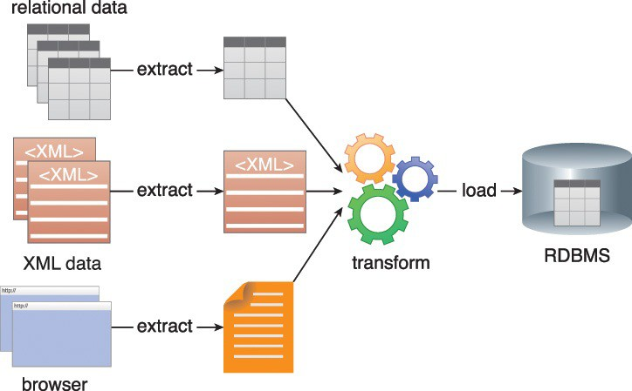
Extract Transform Load (ETL)
Extract Transform Load (ETL) is a process of loading data from a source system into a target system. The source system can be a database, a flat file, or an application. Similarly, the target system can be a database or some other storage system.
Figure 4.3 An ETL process can extract data from multiple sources and transform it for loading into a single target system.

Slide 41
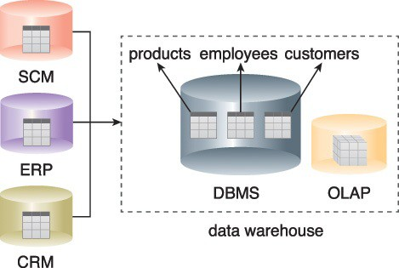
Data Warehouse
A data warehouse is a central, enterprise-wide repository consisting of historical and current data. Data warehouses are heavily used by BI to run various analytical queries, and they usually interface with an OLAP system to support multi-dimensional analytical queries.
Figure 4.4 Batch jobs periodically load data into a data warehouse from operational systems like ERP, CRM and SCM.
Notes:
E-business software systems generally fall into four categories: Enterprise Resource Planning (ERP), Customer Relationship Management (CRM), Supply Chain Management (SCM) and Sales Force Automation (SFA). ERP, CRM, SCM and SFA differ in terms of goals, functionality, users and boundary of the systems.

Slide 42
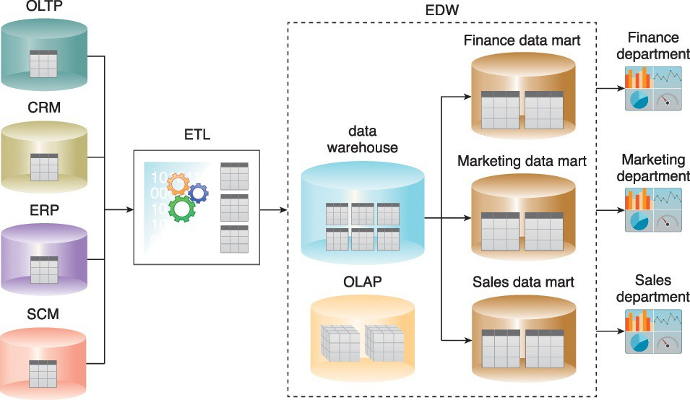
Data Marts
A data mart is a particular subset of the data stored in a data warehouse that typically belongs to a department, division, or specific line of business.
Enterprise-wide data is collected and business entities are then extracted. Domain specific entities are persisted into the data warehouse via an ETL process.
Figure 4.5 A data warehouse’s single version of “truth” is based on cleansed data, which is a prerequisite for accurate and error-free reports, as per the output shown on the right.

Slide 43
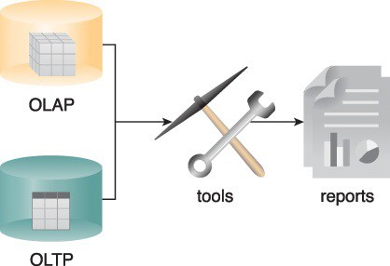
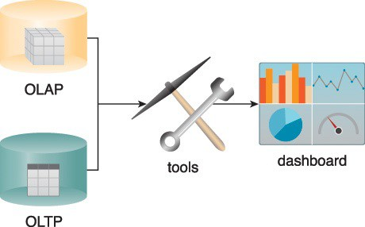
Ad-hoc Reports and Dashboards
Traditional BI primarily utilizes descriptive and diagnostic analytics to provide information on historical and current events. It is not “intelligent” because it only provides answers to correctly formulated questions through:
Ad-hoc reporting is a process that involves manually processing data to produce custom-made reports
Dashboards provide a holistic view of key business areas. The information displayed on dashboards is generated at periodic intervals in real-time or near-realtime.
Figure 4.6 OLAP and OLTP data sources can be used by BI tools for both ad-hoc reporting and dashboards.
Figure 4.7 BI tools use both OLAP and OLTP to display the information on dashboards.

Slide 44
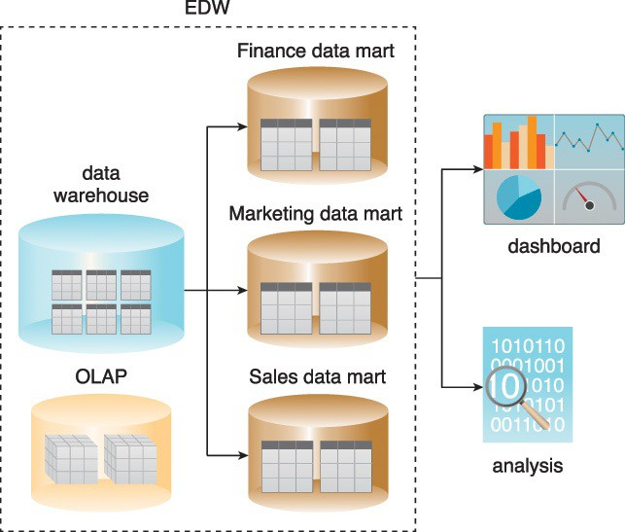
Traditional Business Intelligence
Traditional BI uses data warehouses and data marts for reporting and data analysis because they allow complex data analysis queries with multiple joins and aggregations to be issued
Figure 4.8 An example of traditional BI.

Slide 45
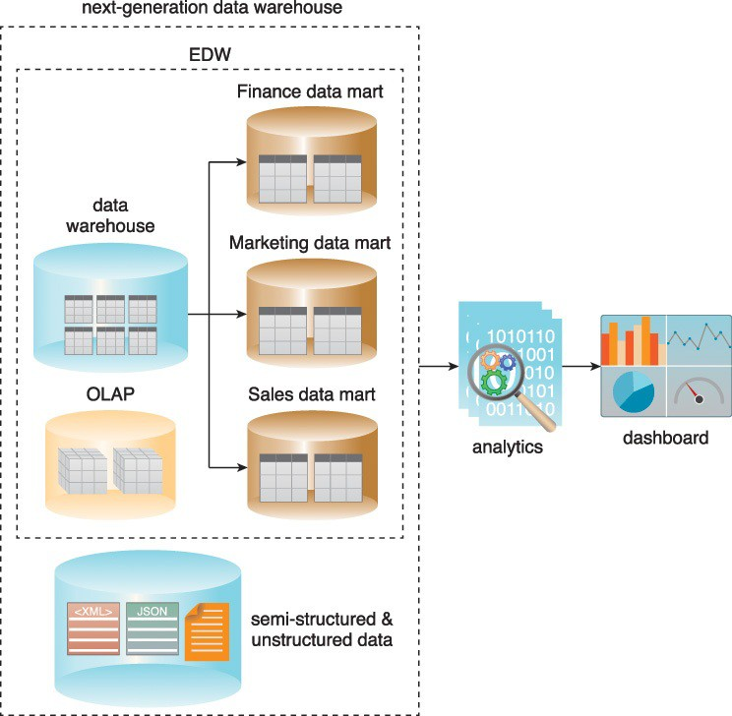
Big Data Business Intelligence
Big Data BI builds upon traditional BI by acting on the cleansed, consolidated enterprise- wide data in the data warehouse and combining it with semi-structured and unstructured data sources.
It comprises both predictive and prescriptive analytics to facilitate the development of an enterprise-wide understanding of business performance.
Figure 4.9 A next-generation data warehouse.

Slide 46
Traditional & Big Data Visualizations
Data visualization is a technique whereby analytical results are graphically communicated, interpreted, and portrayed using elements like charts, maps, data grids, infographics and alerts.
Graphically representing data can make it easier to understand reports, view trends and identify patterns.
Big Data solutions require data visualization tools that can seamlessly connect to structured, semi-structured and unstructured data sources and are further capable of handling millions of data records.
Data visualization tools for Big Data solutions generally use in-memory analytical technologies that reduce the latency normally attributed to traditional, disk-based data visualization tools.

Slide 47
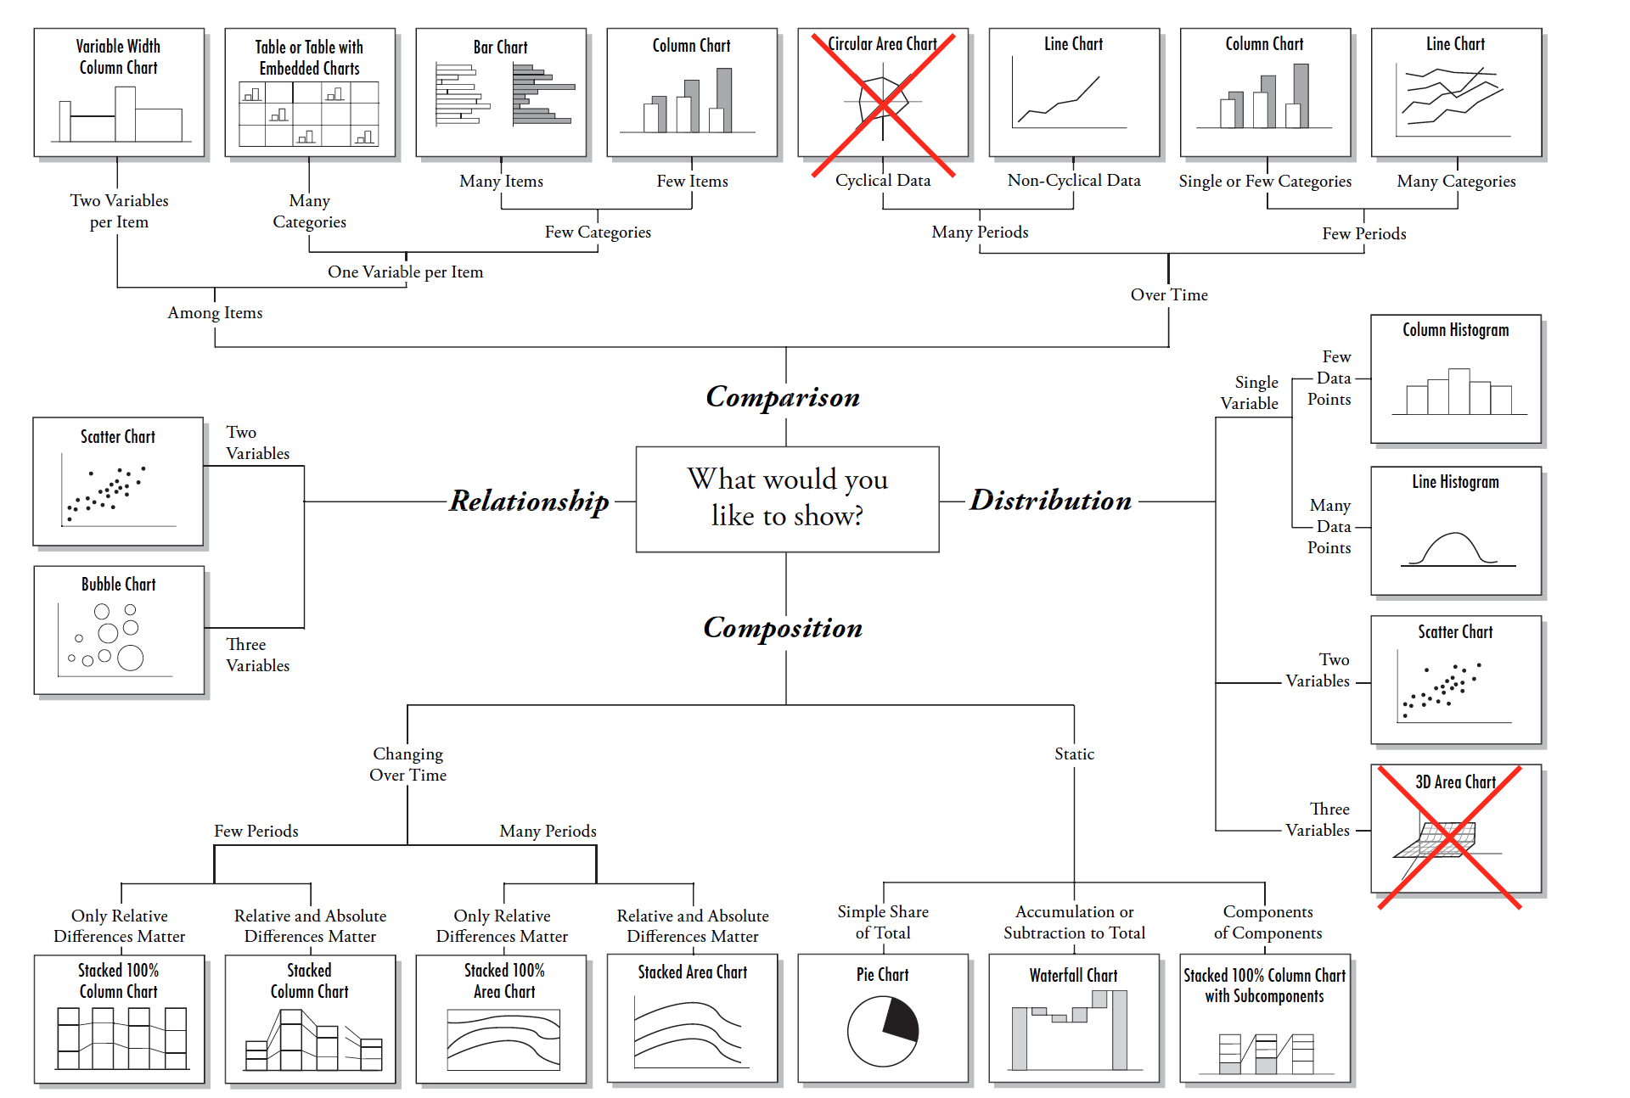
Visualization Types

Slide 48
Python
Python as a Programming Language
Python is a general-purposed high-level programming language
Web development
Networking
Scientific computing
Data analytics
…

Slide 49
Python for Data Analytics
Python as a Data Analytics Tool
The nature of Python makes it perfect-fit for data analytics
Easy to learn
Readable
Scalable
Extensive set of libraries
Easy integration with other apps
Active community & ecosystem

Slide 50
Portfolio’s
iPython & Jupyter Notebook
iPython is a Python command shell for interactive computing
Jupyter Notebook (the former iPython Notebook) is a web-based interactive data analysis environment that supports iPython
20

Slide 51
Commonly Used Data Sciences Tools
Library | Usage
numpy, scipy | Scientific & technical computing
pandas | Data manipulation & aggregation
mlpy, scikit-learn | Machine learning
theano, tensorflow, keras | Deep learning
statsmodels | Statistical analysis
nltk, gensim | Text processing
networkx | Network analysis & visualization
bokeh, matplotlib, seaborn, plotly | Visualization
beautifulsoup, scrapy | Web scraping

